Slide 1

Ketch
Beaton / Butler / Carder / Greeson

Slide 2
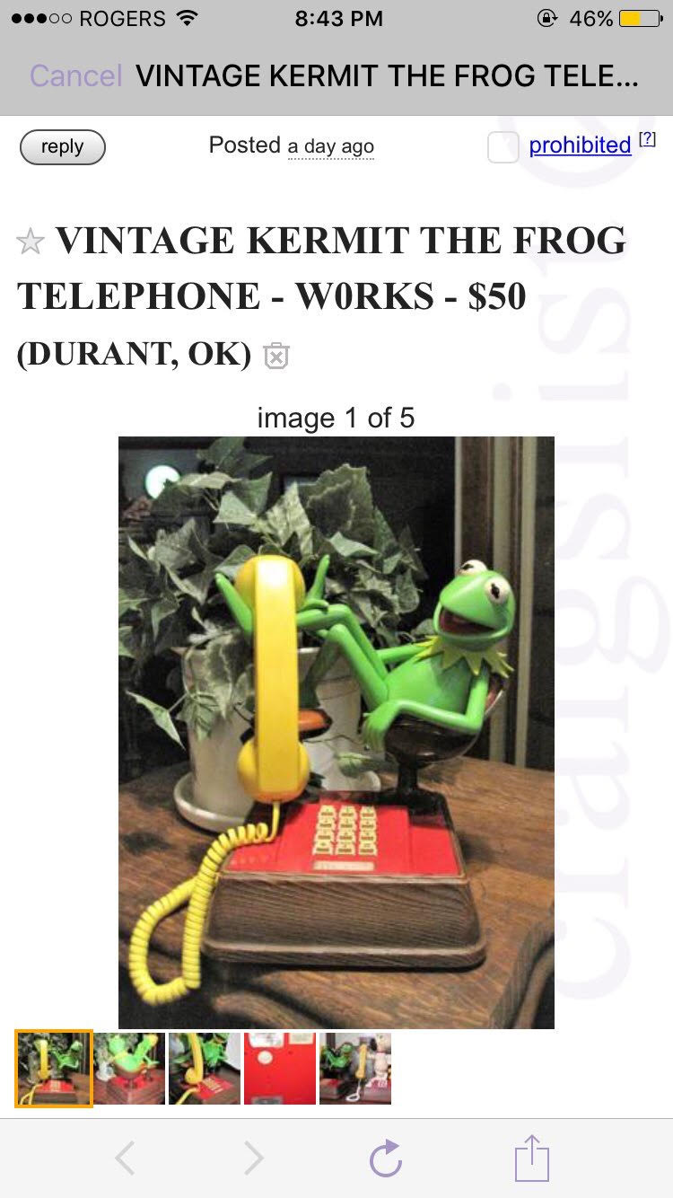
Problem?

Slide 3
Ketch is a mobile application designed to buy and sell goods locally between two parties in a safe, easy and effective manner.

Slide 4
Requirements
User-Interface
Item listings(where the seller posts)
Facebook login page
Account information
Individual item view
Favorites page
Chat system
Dashboard
Functional
Message between users and buyer
Show items based upon location
Customer support tutorial
Edit account information
Feedback system
Create and sell an item
Upload pictures
Technical
iOS 10.1
100 MB of Storage
Security
Payment system is done through stripe
Facebook login to validate identities
Chat system is done in-app
User rating/report system

Slide 5

Firebase
Database
NoSQL cloud database
Data stored as JSON
Data is synced across all clients
Remains available when offline
Authentication
Allows app to be secure
Easily expand authentication methods (gmail, Facebook, etc.)
Storage
Cloud Storage that stores user-generated content
Contains pictures that users upload and creates an i.d. for the database to reference
Hosting
Deploys Web and mobile Web apps
Allows for one-click rollbacks

Slide 6
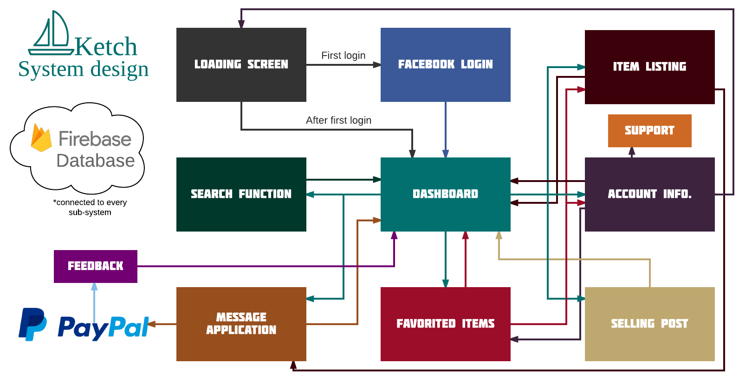

Slide 7

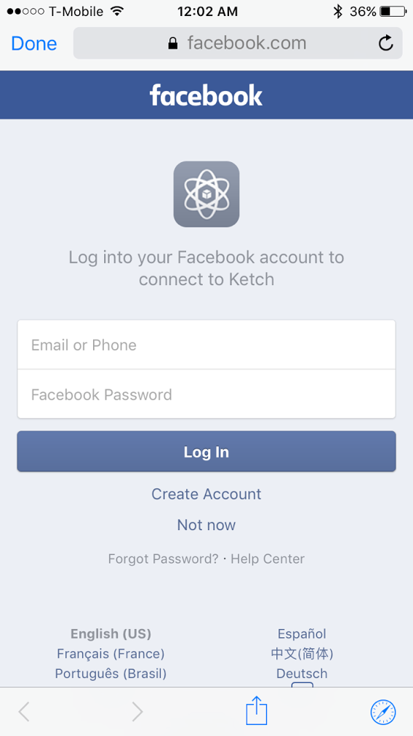
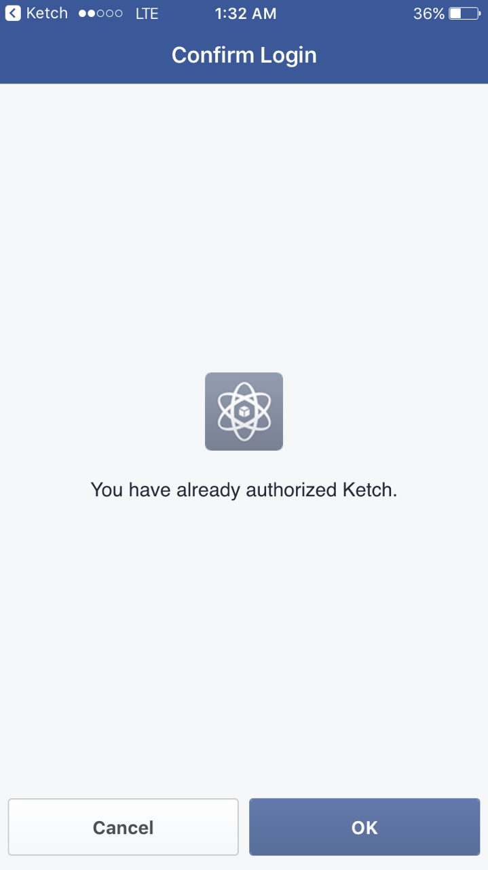
Initial Login and Authorization
Profiles linked to unique Facebook users
The login screen is used to create a new account through Facebook and Firebase
If the user is currently logged in, the app will bypass the login screen

Slide 8
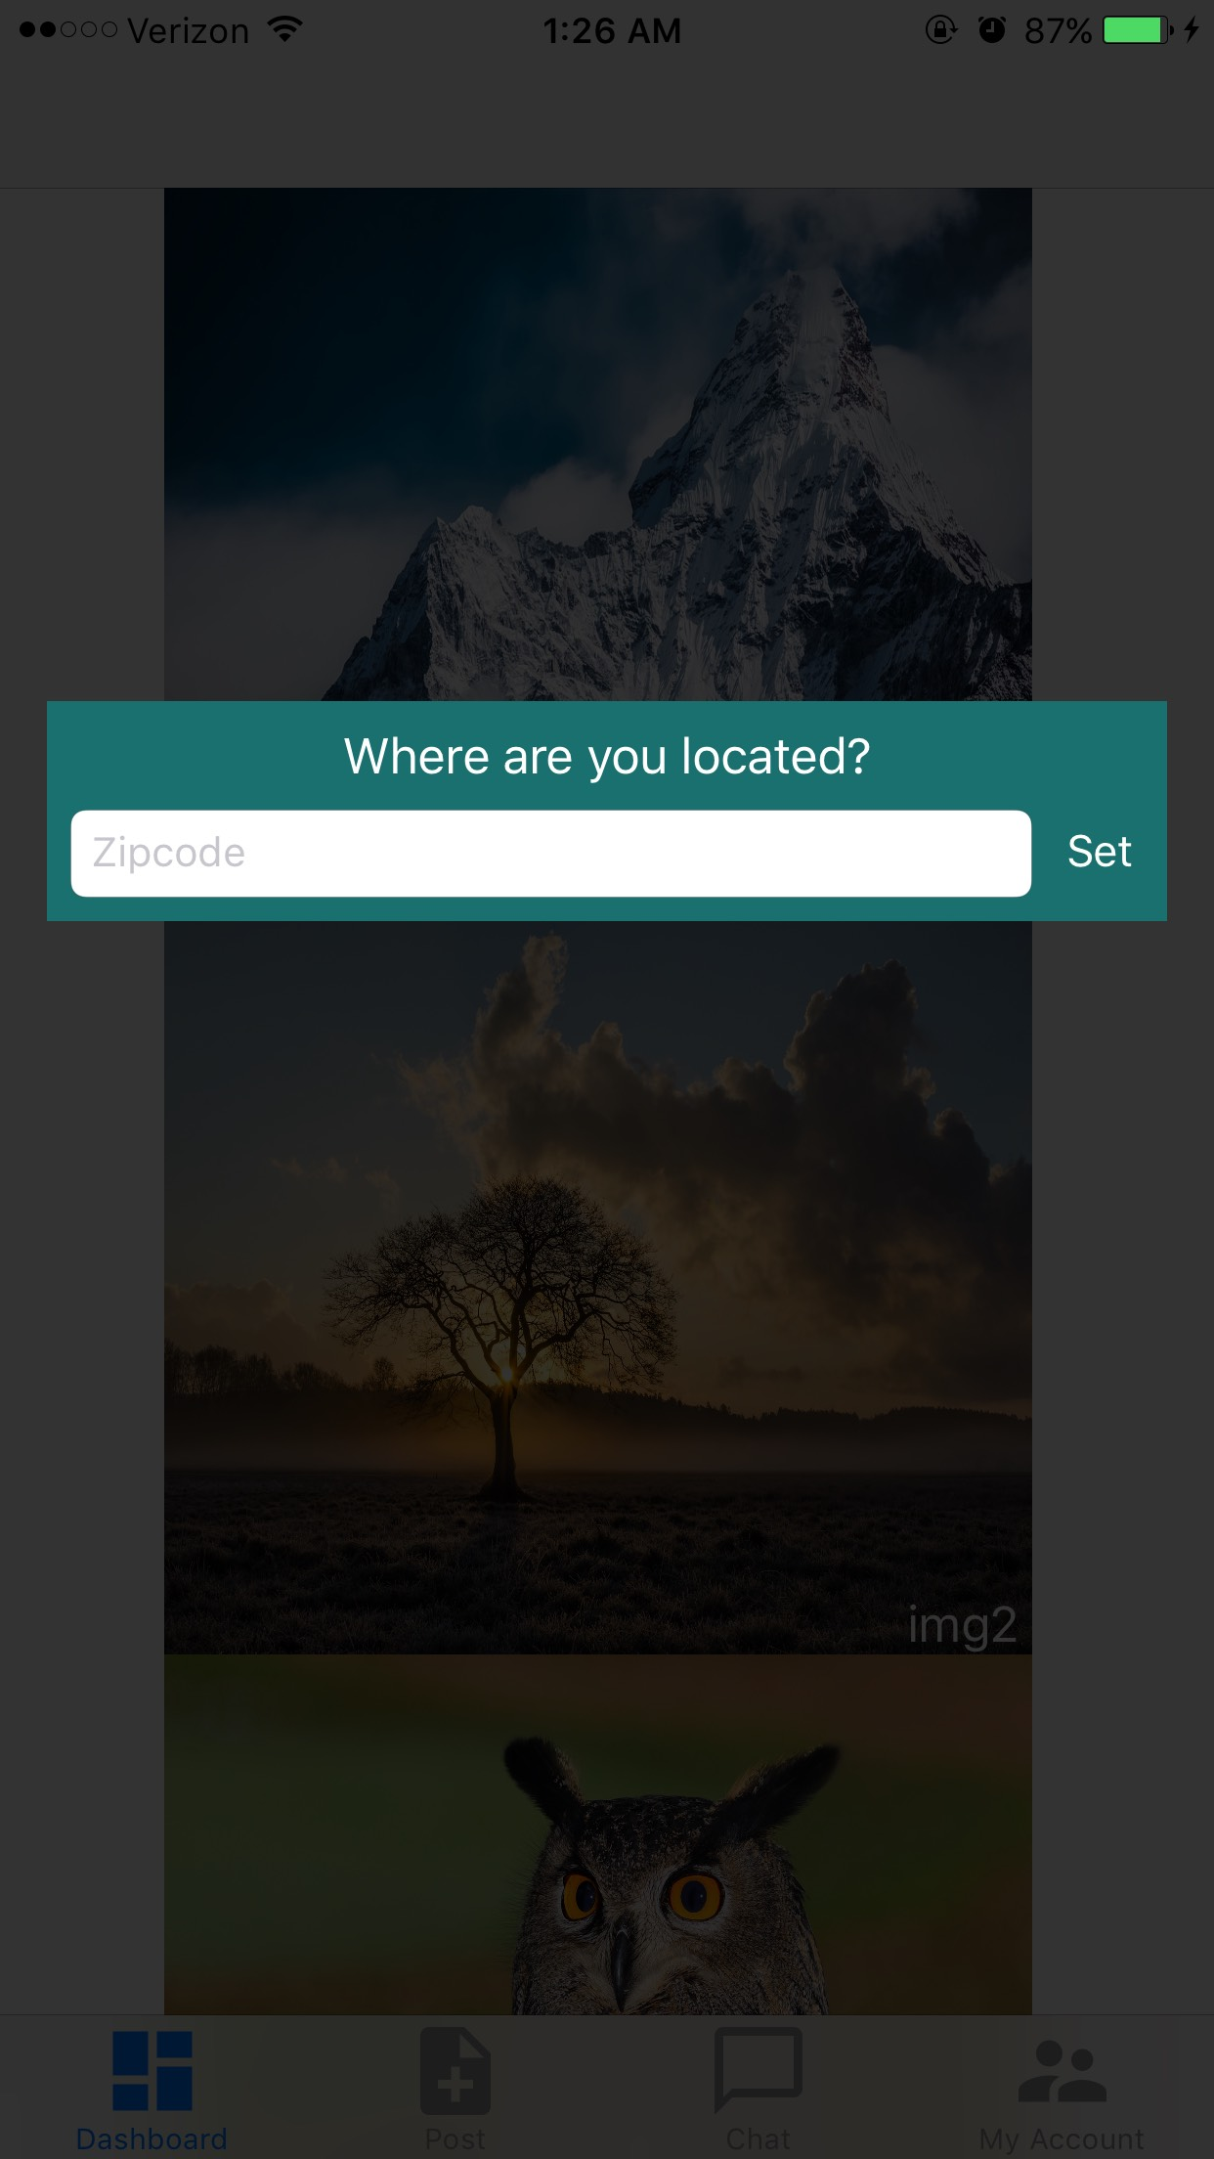
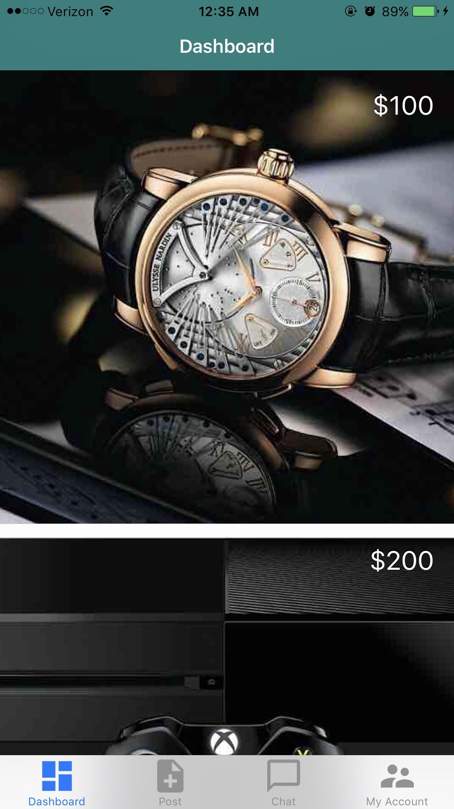
Initial Setup and Dashboard
Upon first entering the application, zipcode is to be set by the user and can be changed later by the user on the account page.
A user can select an image pulling up an item page and the user can also navigate throughout all functions on the application.

Slide 9
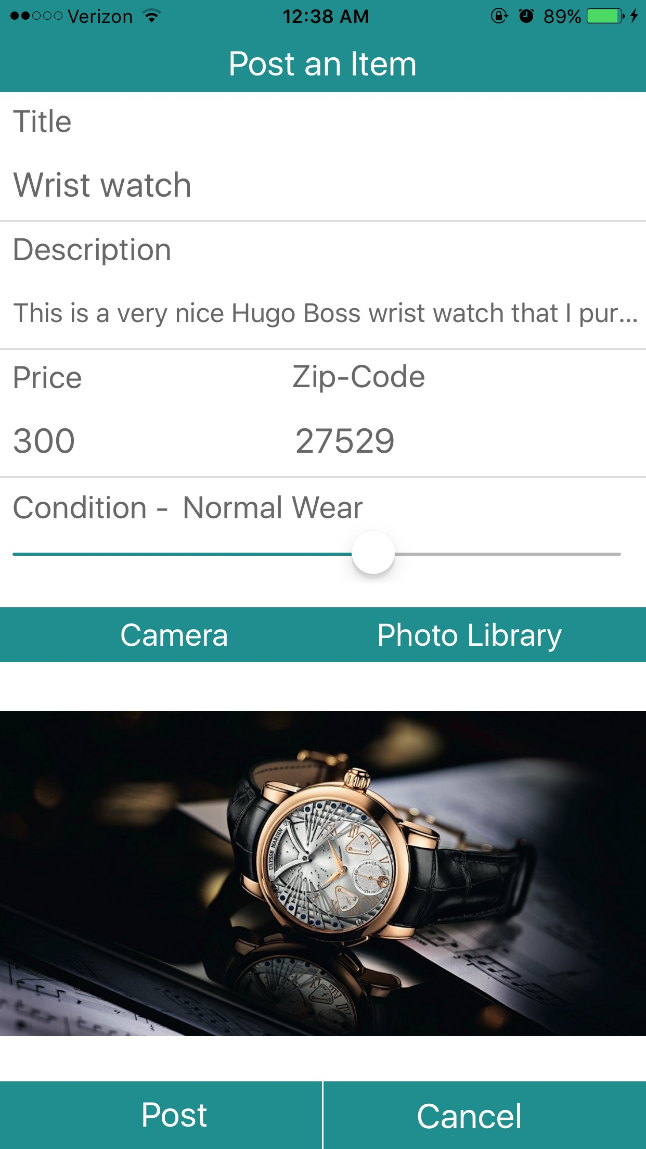
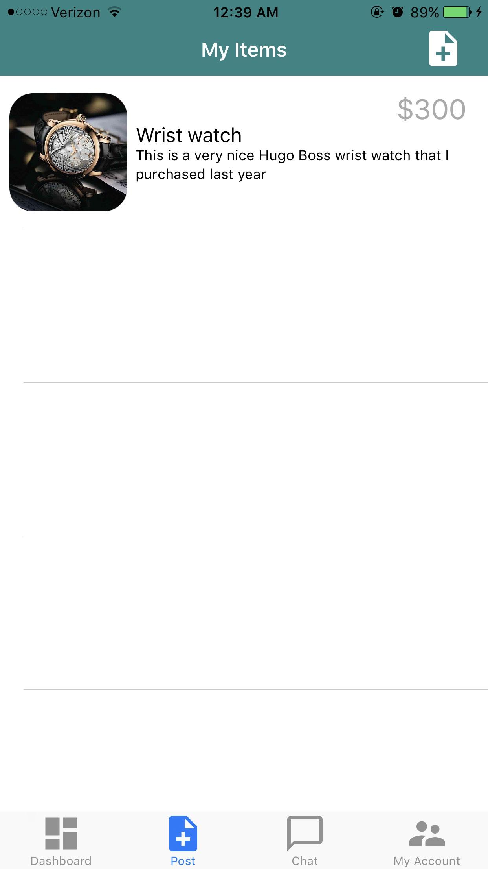
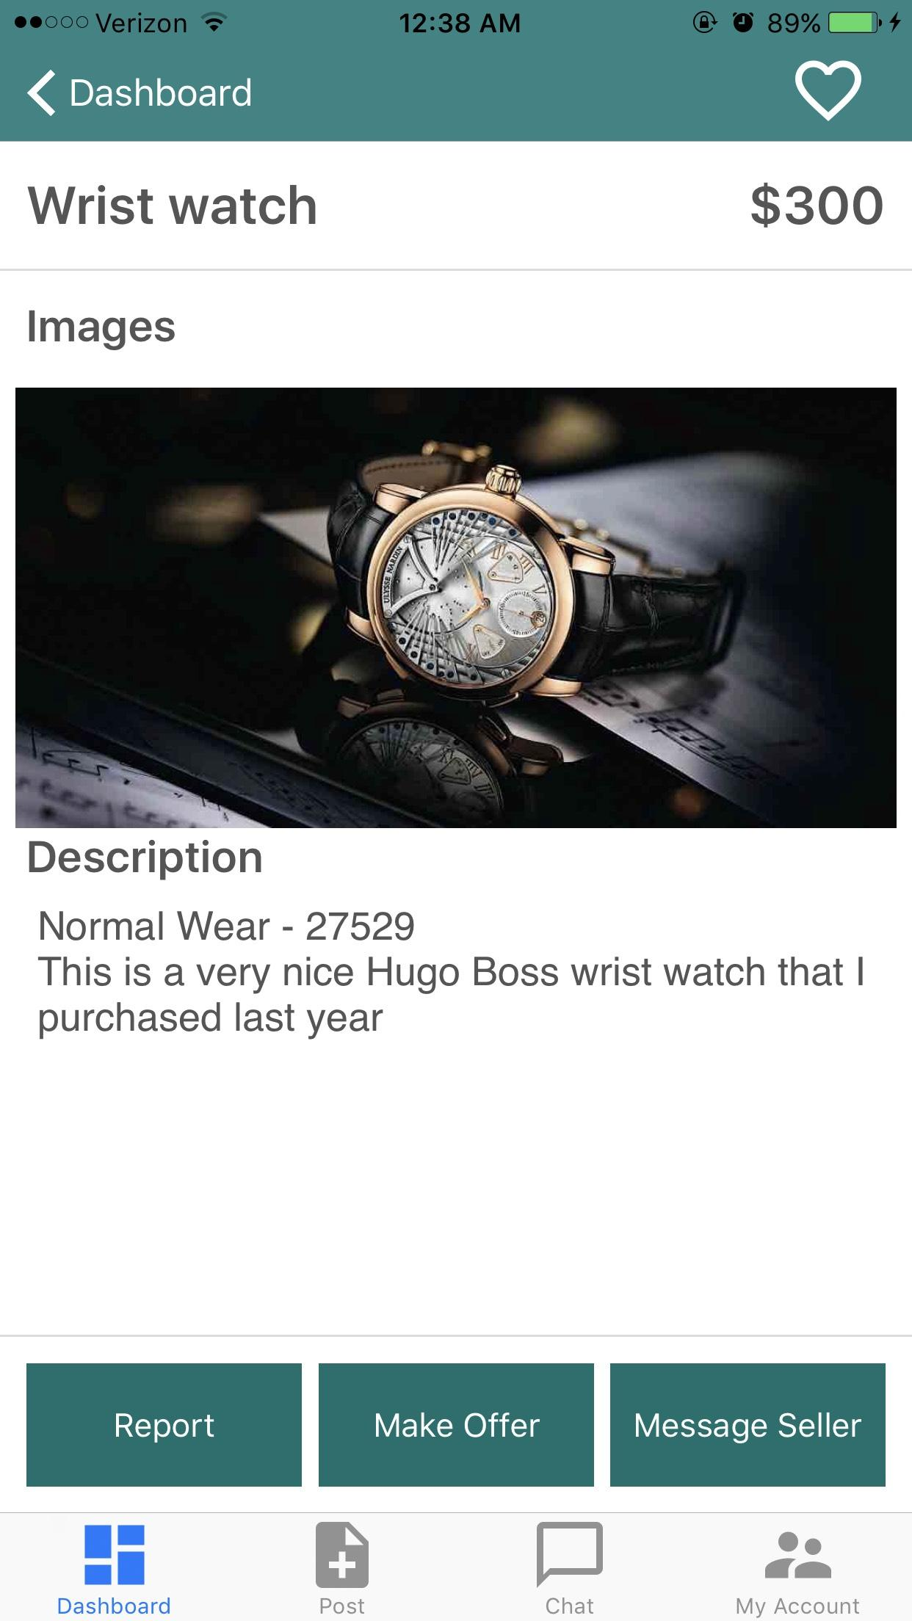
Selling Post and Item Page
User goes to post at dashboard
My items shows all items for sale, the can be deleted from this page as well(swipe to delete)
Post an Item allows the User to fill in the required text and upload a picture for the item being sold
Item page is the link between Buyer and Seller

Slide 10
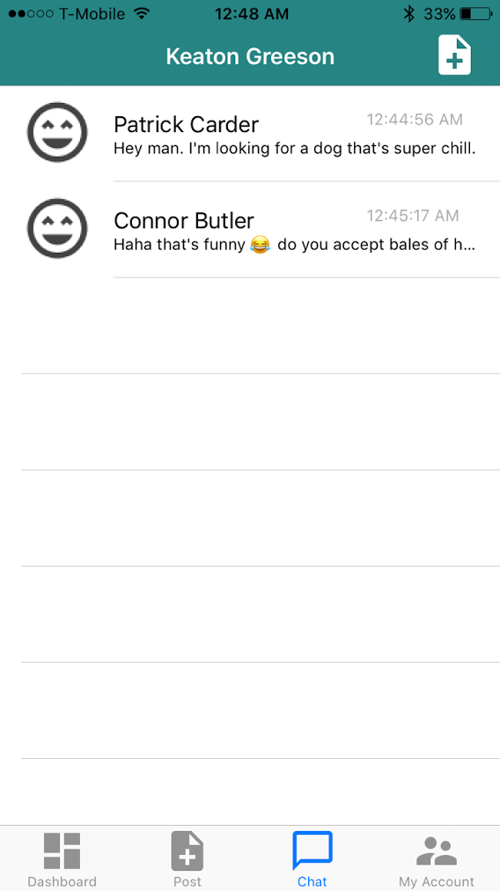
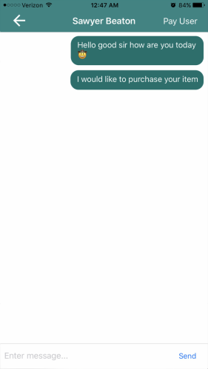
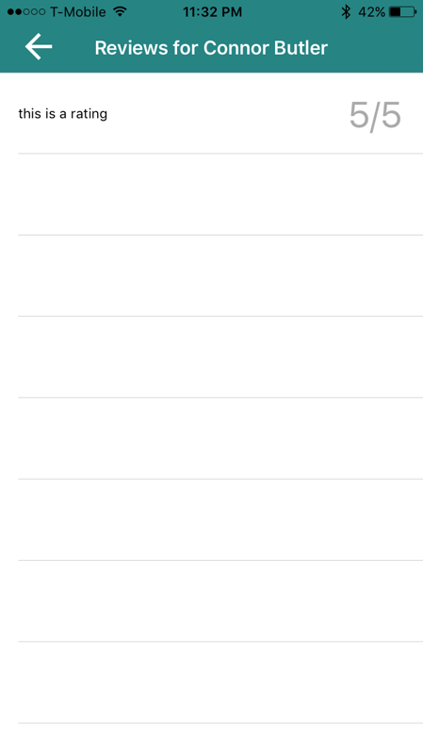
Message Function and Rating System
Chat tab brings you to you message inbox
Once you click on a name it brings up the individual conversation
If you click the user’s name you can see the reviews for a person

Slide 11
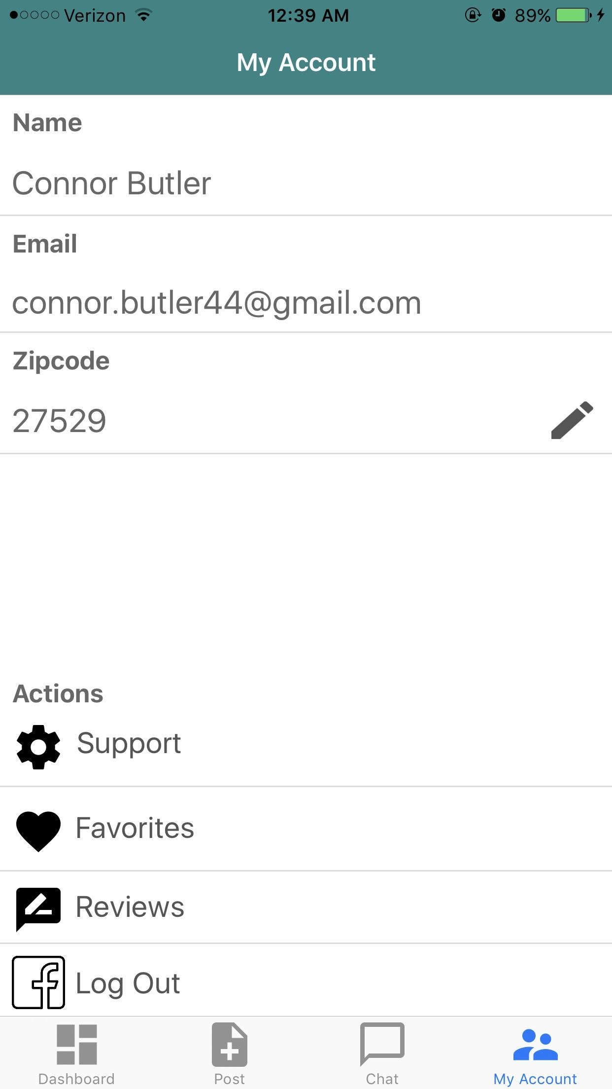
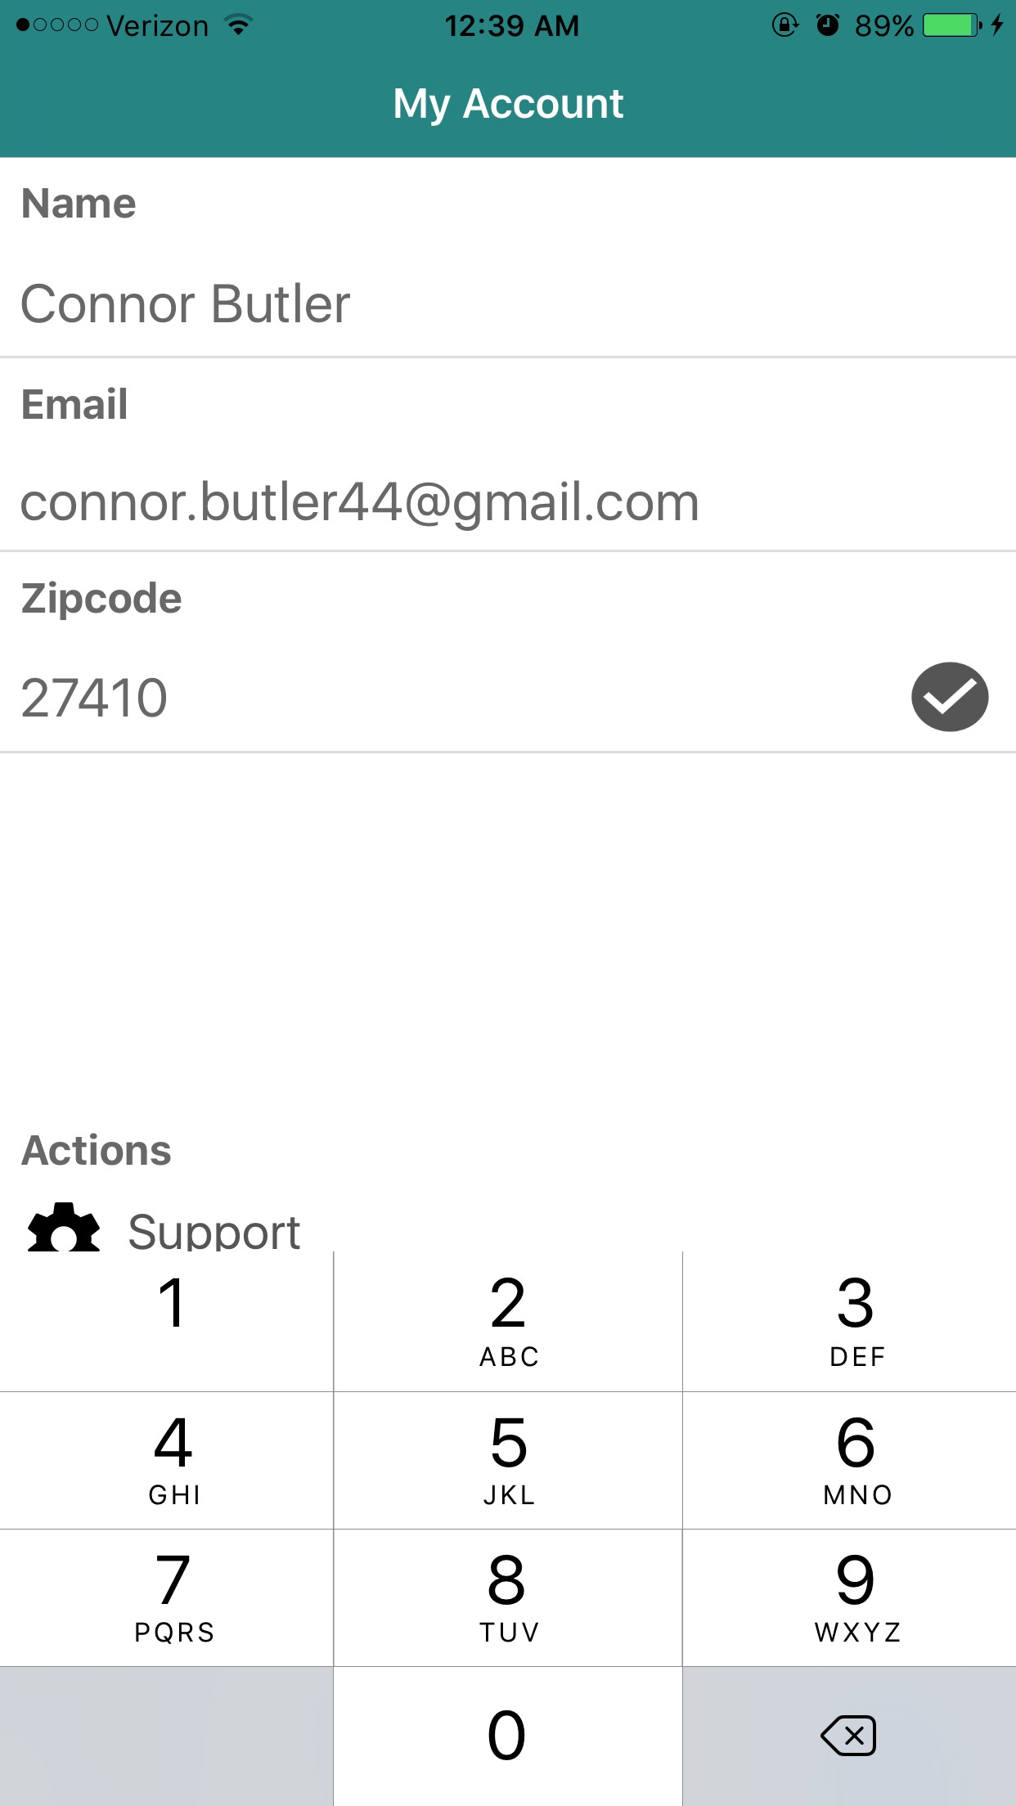
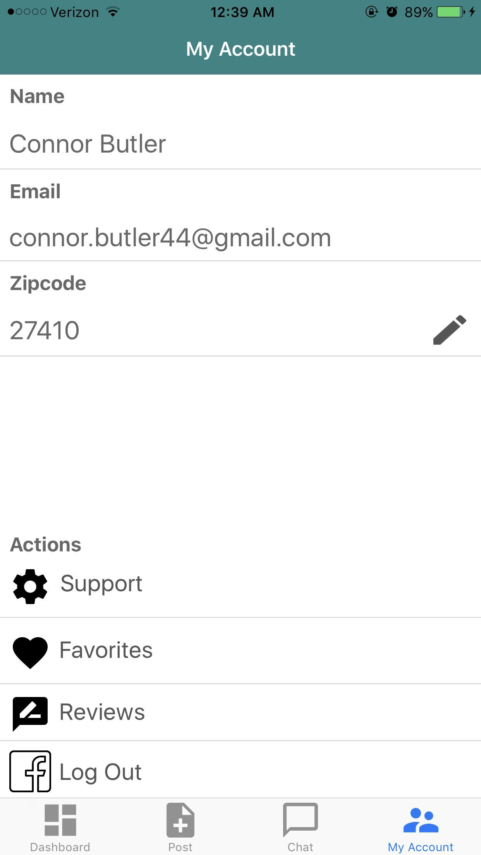
Account Page and Changing Zip-Code
Account Page holds the User's information
The User can view his/her Favorited Items and Reviews
The User may also Log Out from the Account Page.

Slide 12
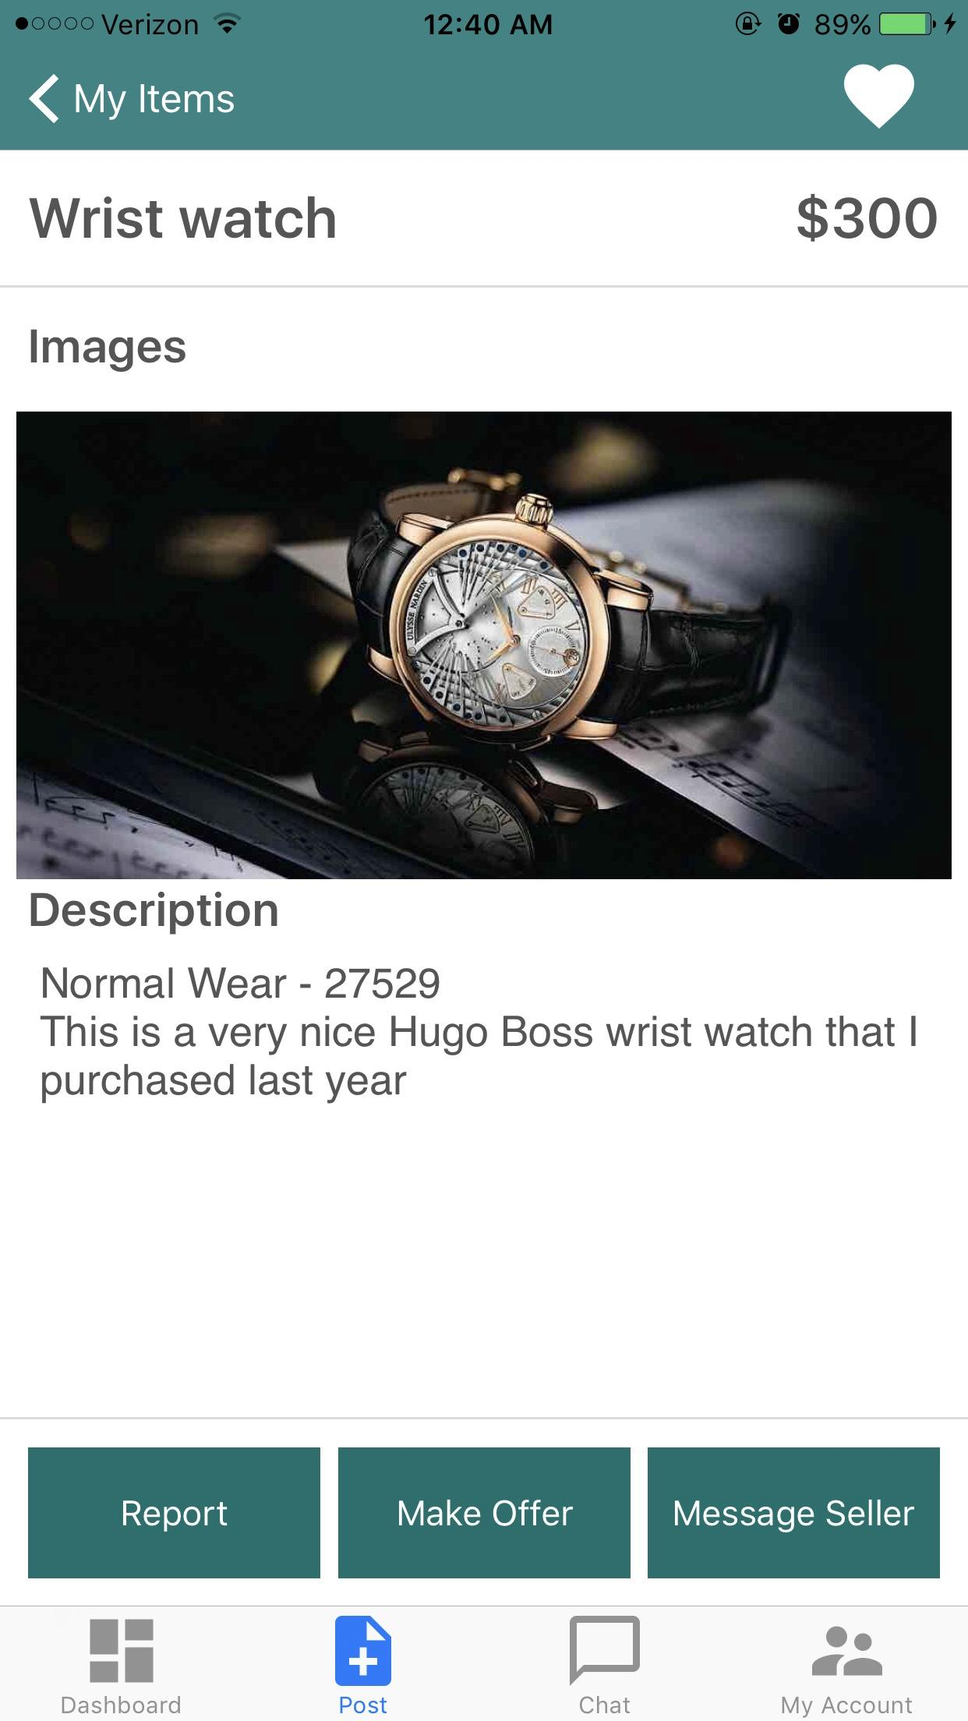
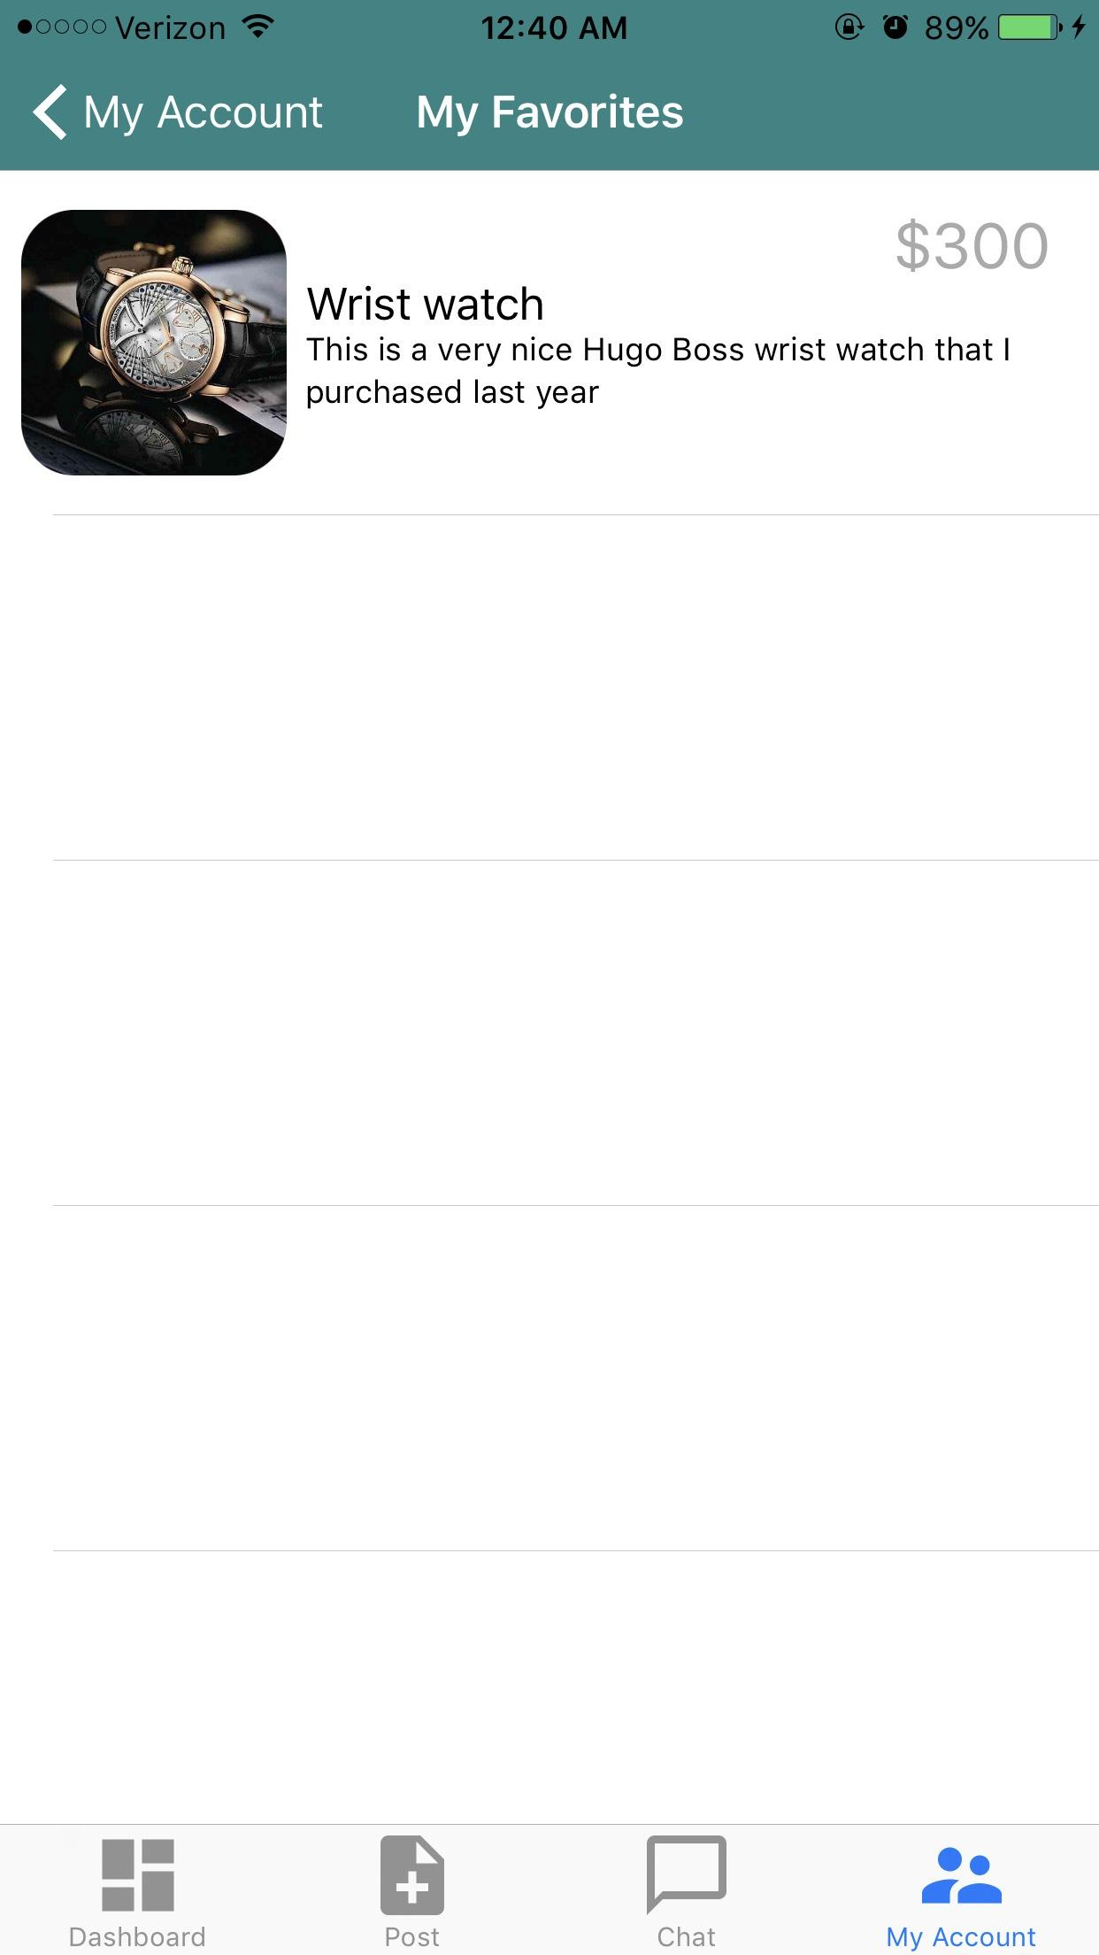
Favorited Items
Users can click the heart on item pages to “favorite” them and track them
These favorited items are stored on the Account Page

Slide 13
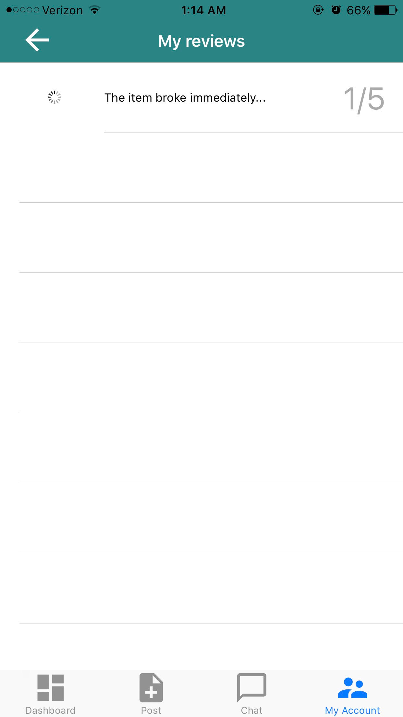
Review System
Can be viewed by through the Messaging Function
User can view on Reviews on their Account Page

Slide 14
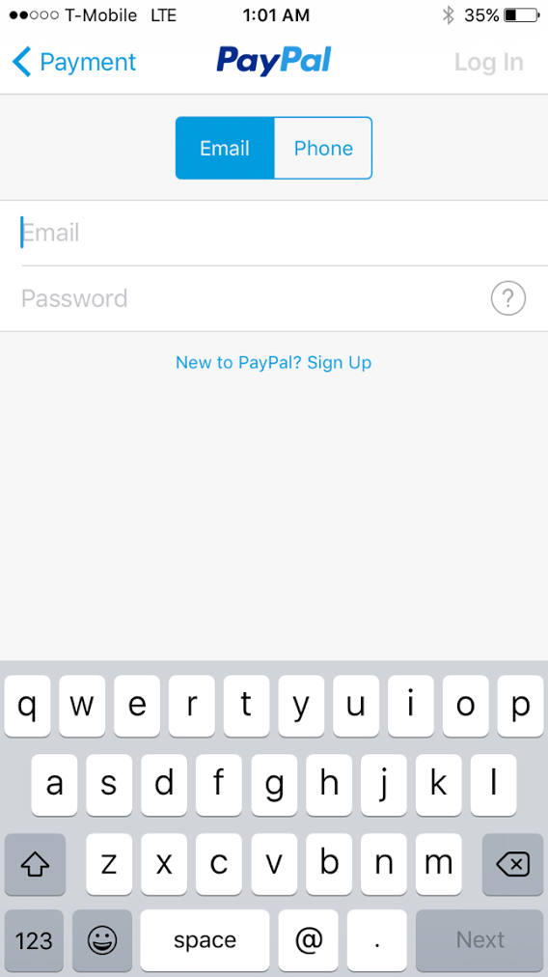
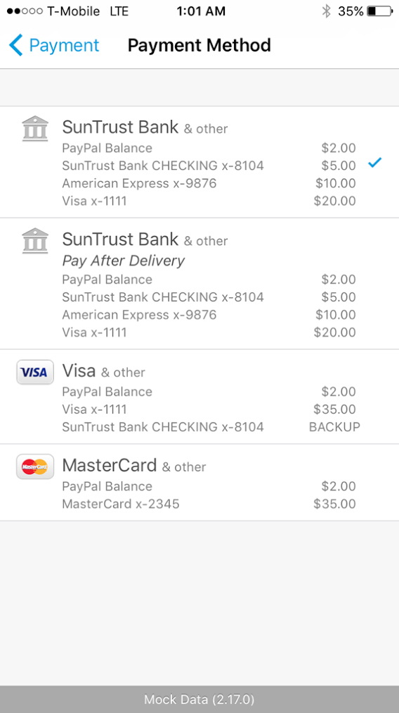
PayPal
Accessed through individual conversations
User can enter their PayPal information and purchase items from the seller of an item

Slide 15
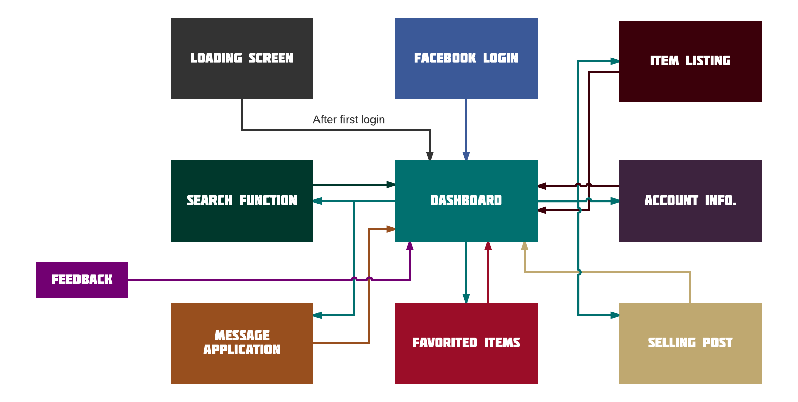
Homepage
Homepage

Slide 16
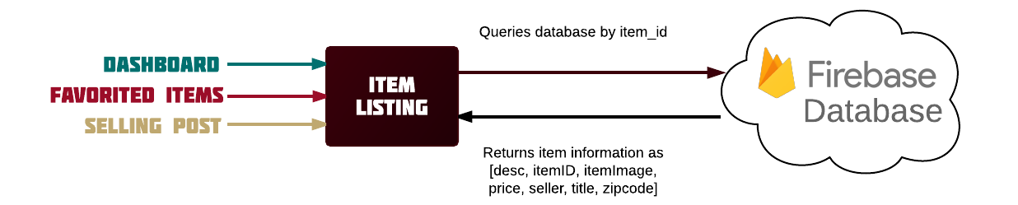
Homepage
Item Page

Slide 17
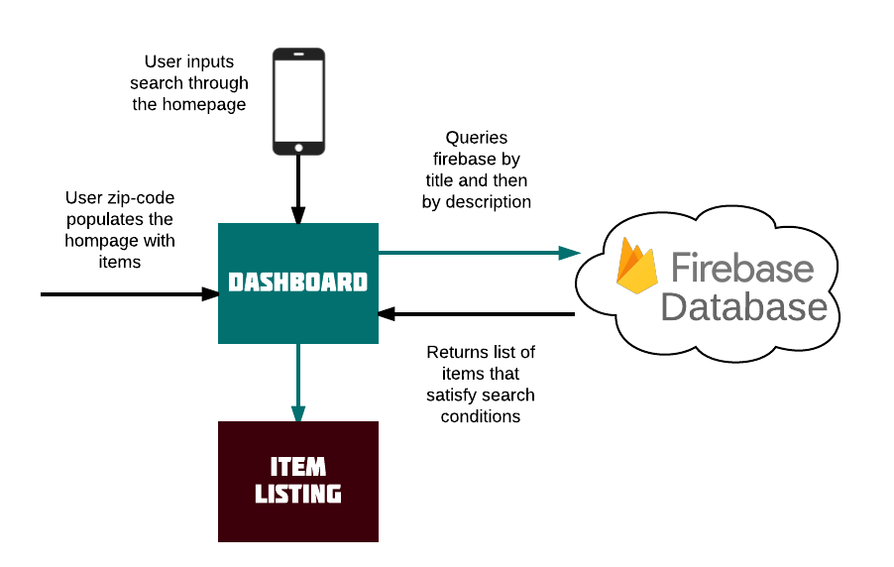
Homepage
Search Function

Slide 18
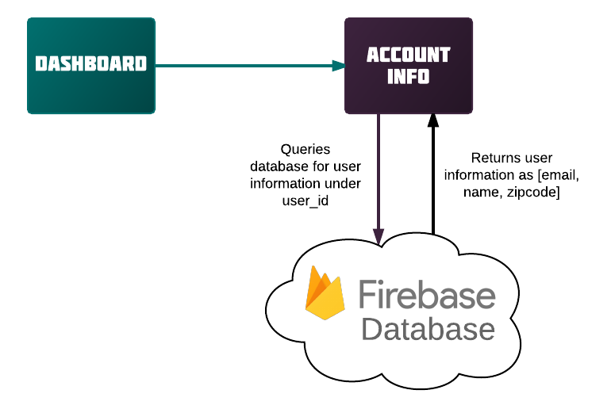
Homepage
Account Information

Slide 19
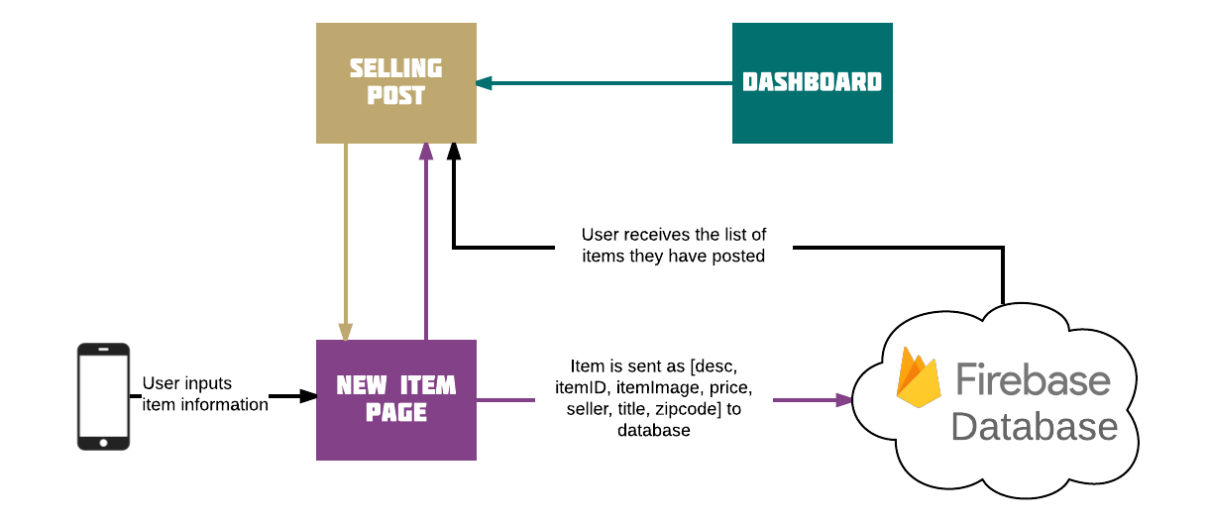
Homepage
Selling Post / New Item Page

Slide 20
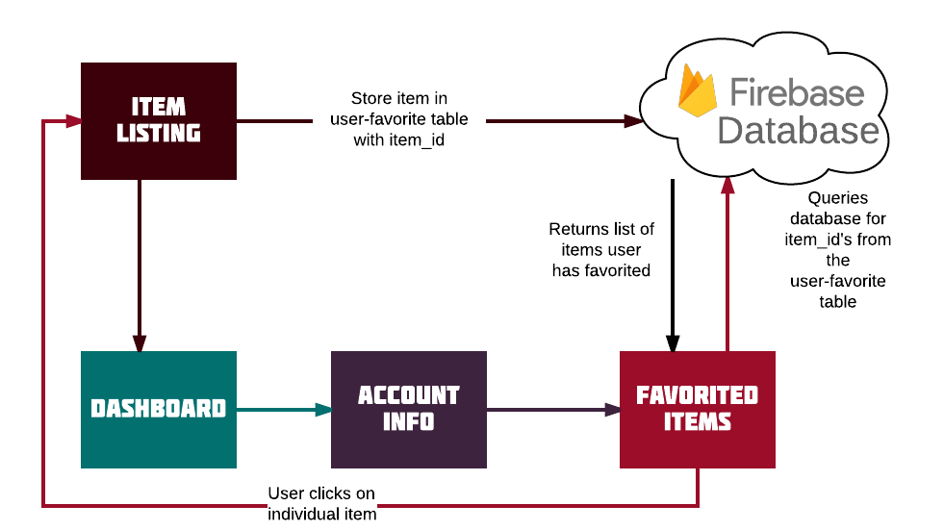
Homepage
Items Being Tracked

Slide 21
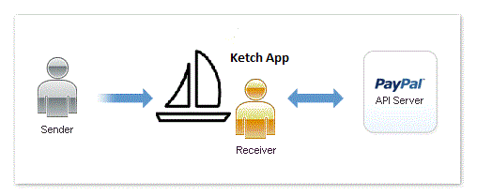
Homepage
PayPal
https://github.com/paypal/PayPal-iOS-SDK

Slide 22
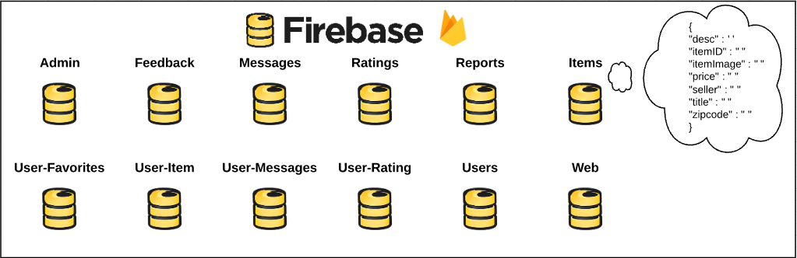
Database

Slide 23
Demo!

Slide 24
Future Efforts
Functionality
Upload multiple images for an item
Send images/videos in chat
Categorize items
Transaction history
Sophisticated search system
Detailed analytics
Link messages to a specific item
Link item information to PayPal
Technical
Android implementation of Ketch

Slide 25
Website
https://ketch-b8d8a.firebaseapp.com/

Slide 26
Questions?

Slide 27
Homepage
References
[1]”Features - Firebase”, Firebase, 2017. [Online]. Available: https://firebase.google.com/features/. [Accessed: 08- Mar- 2017].
[2]B. Lim, ”Introducing Cloud Functions for Firebase”, The Firebase Blog, 2017. [Online]. Available: https://firebase.googleblog.com/2017/03/introducingcloud-functions-for-firebase.html. [Accessed: 10- Mar- 2017].
[3]M. Maher, ”Introduction to Firebase: Building a Simple Social App in Swift”, Appcoda.com, 2016. [Online]. Available: https://www.appcoda.com/firebase/. [Accessed: 09- Mar- 2017].

